Slide 1
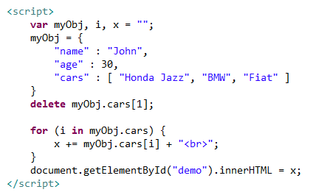
JSON Arrays
We can use se the delete keyword to delete items from an array.

